Slide 1


Slide 2


Slide 3
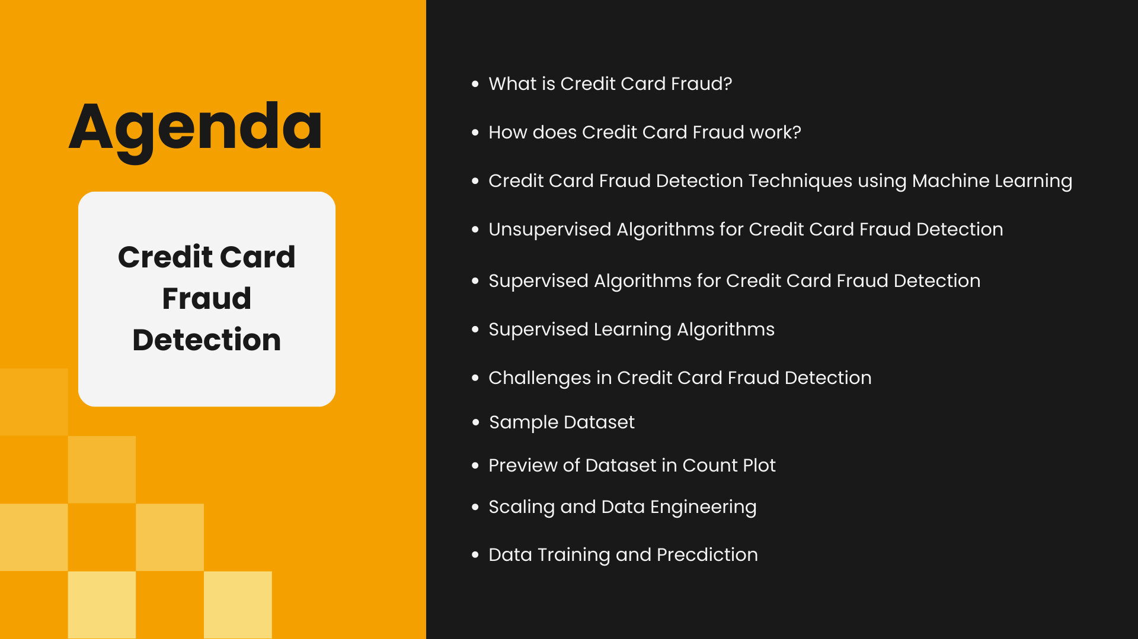

Slide 4


Slide 5


Slide 6


Slide 7
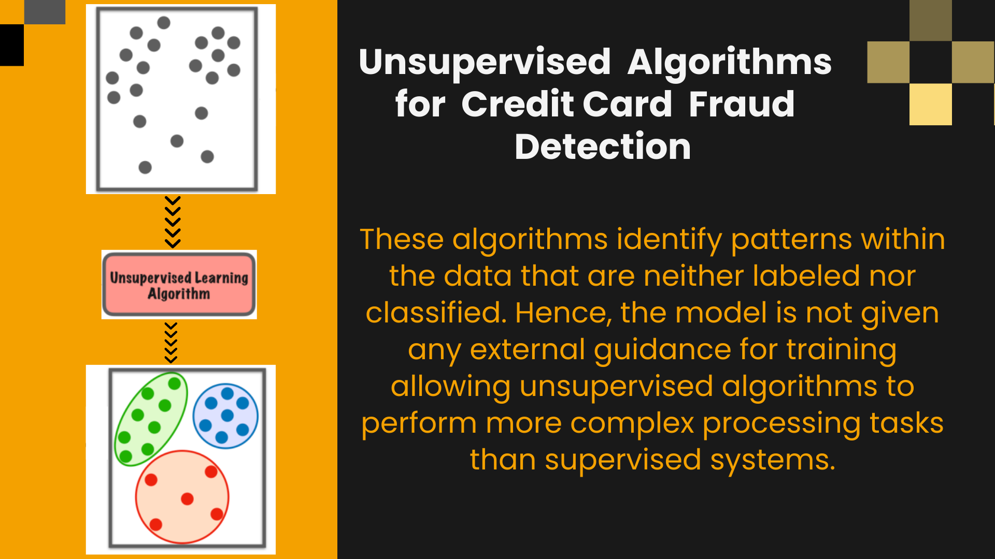

Slide 8


Slide 9
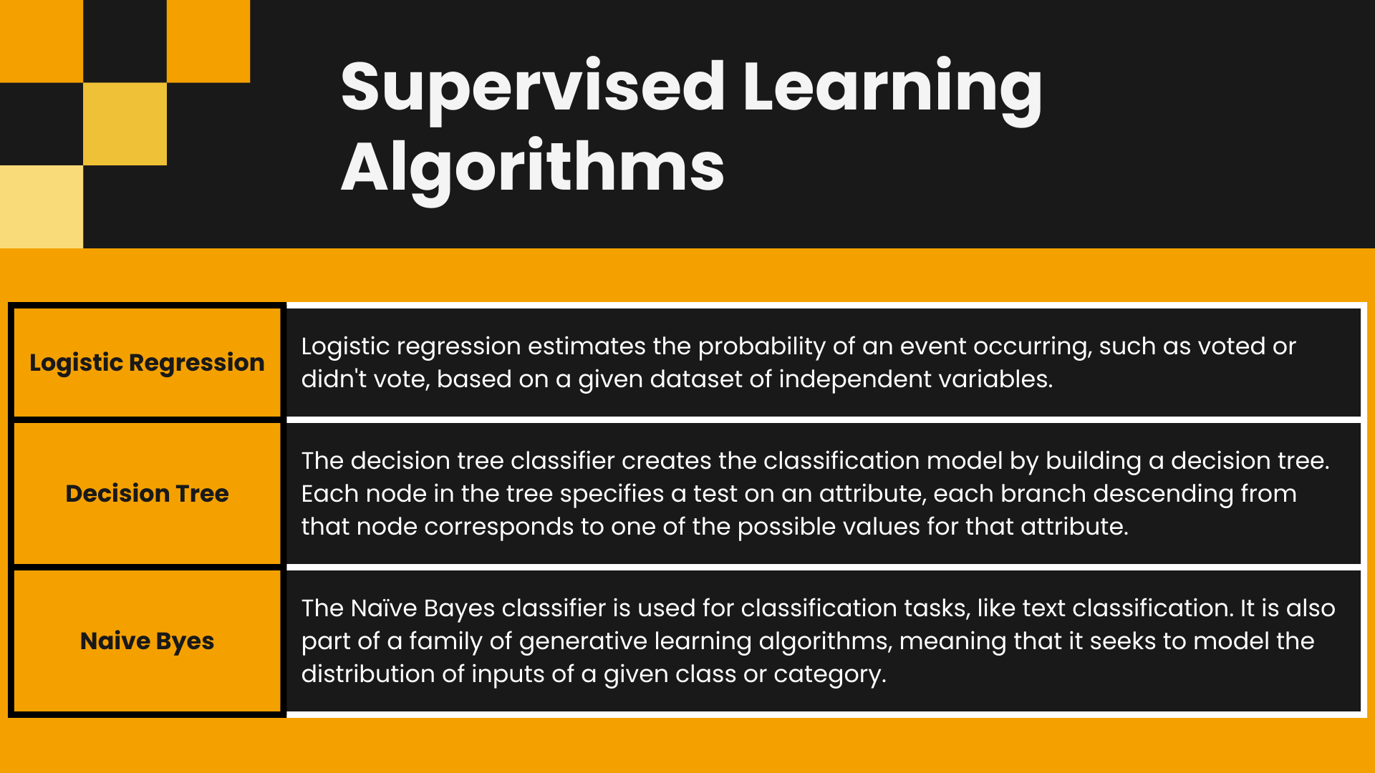

Slide 10
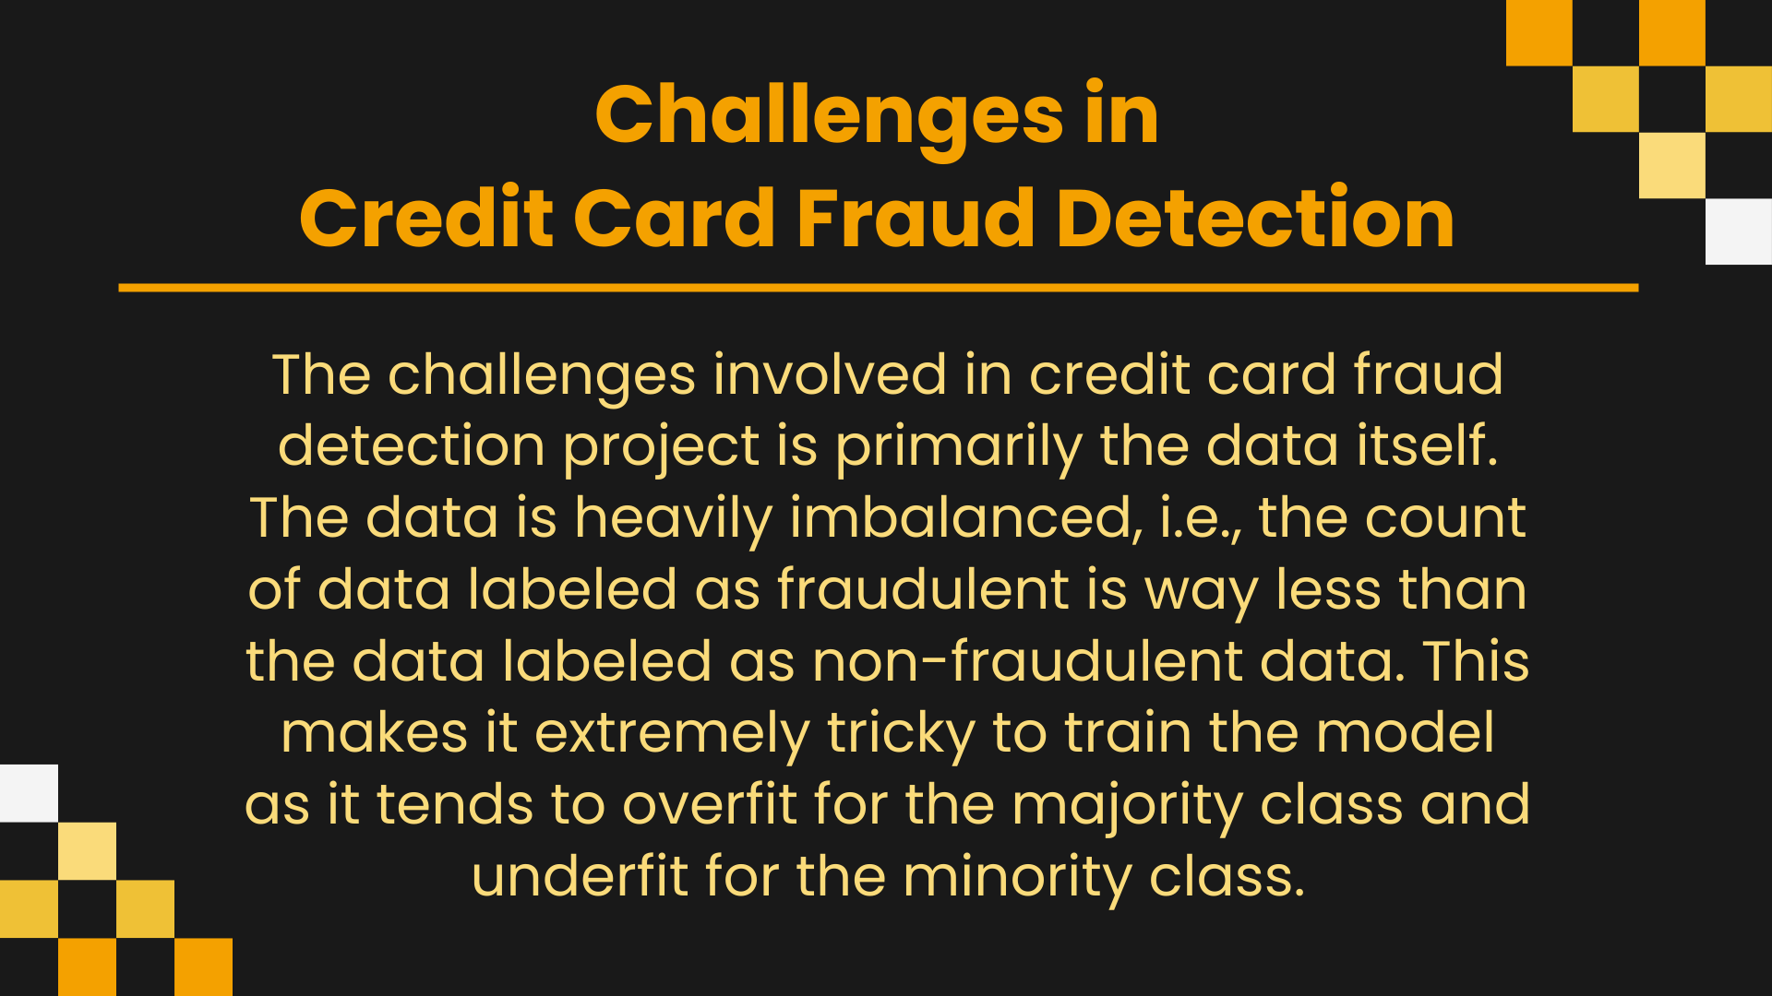

Slide 11
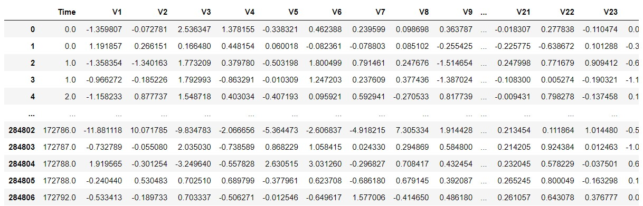
SAMPLE DATA

Slide 12
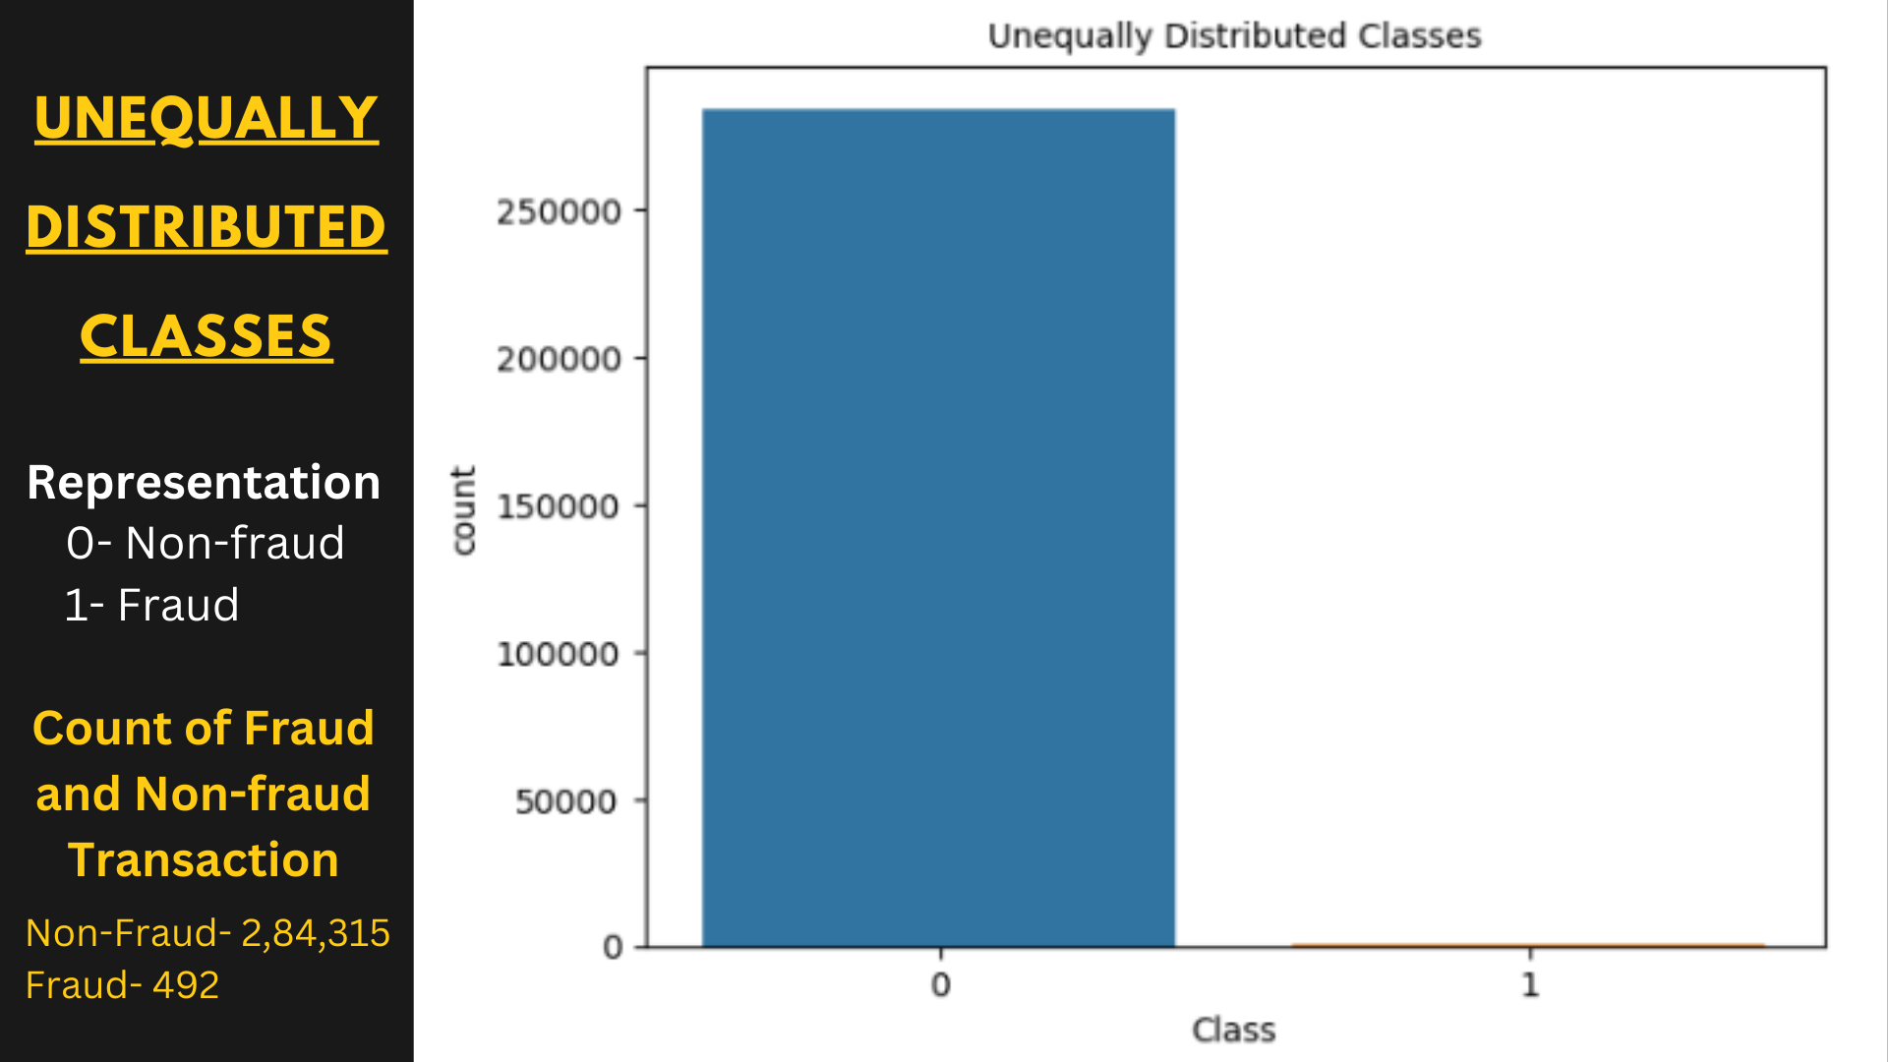

Slide 13
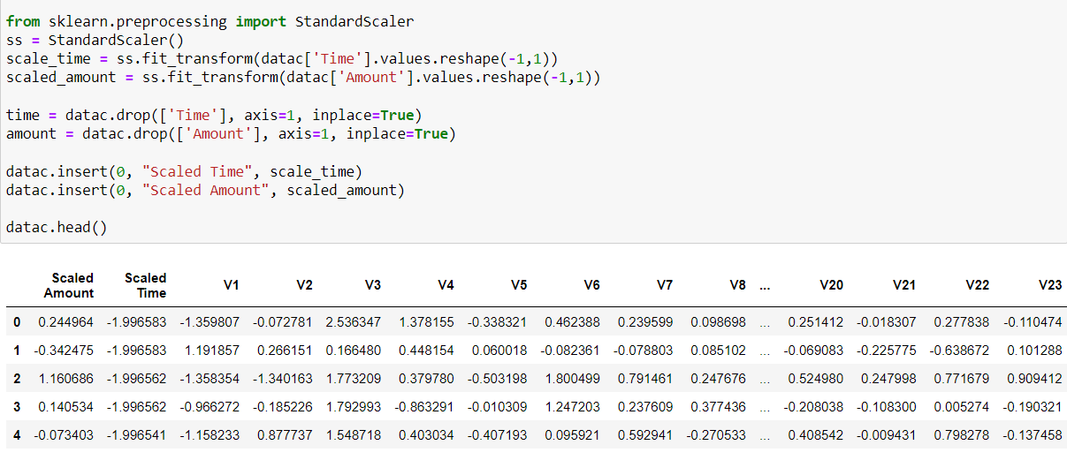
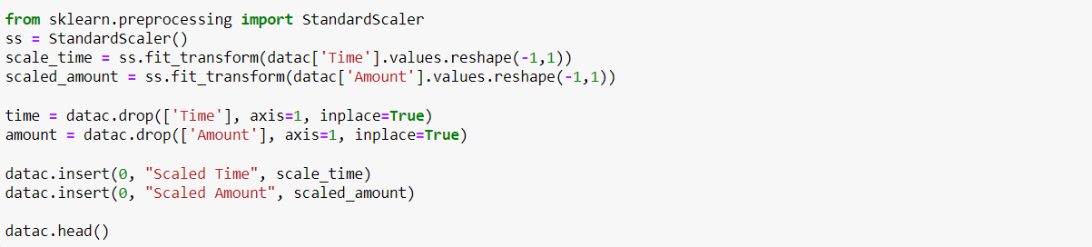
STANDARD SCALER

Slide 14
As there are very less count of fraud transaction therefore we have to create a new sample dataset that will have equal amount of Fraud and Non-Fraud transaction.
fraud = datac.loc[data[‘Class’] == 1]
non_fraud = datac.loc[data[‘Class’] == 0][:492]
dataeq = pd.concat([fraud, non_fraud])

Slide 15
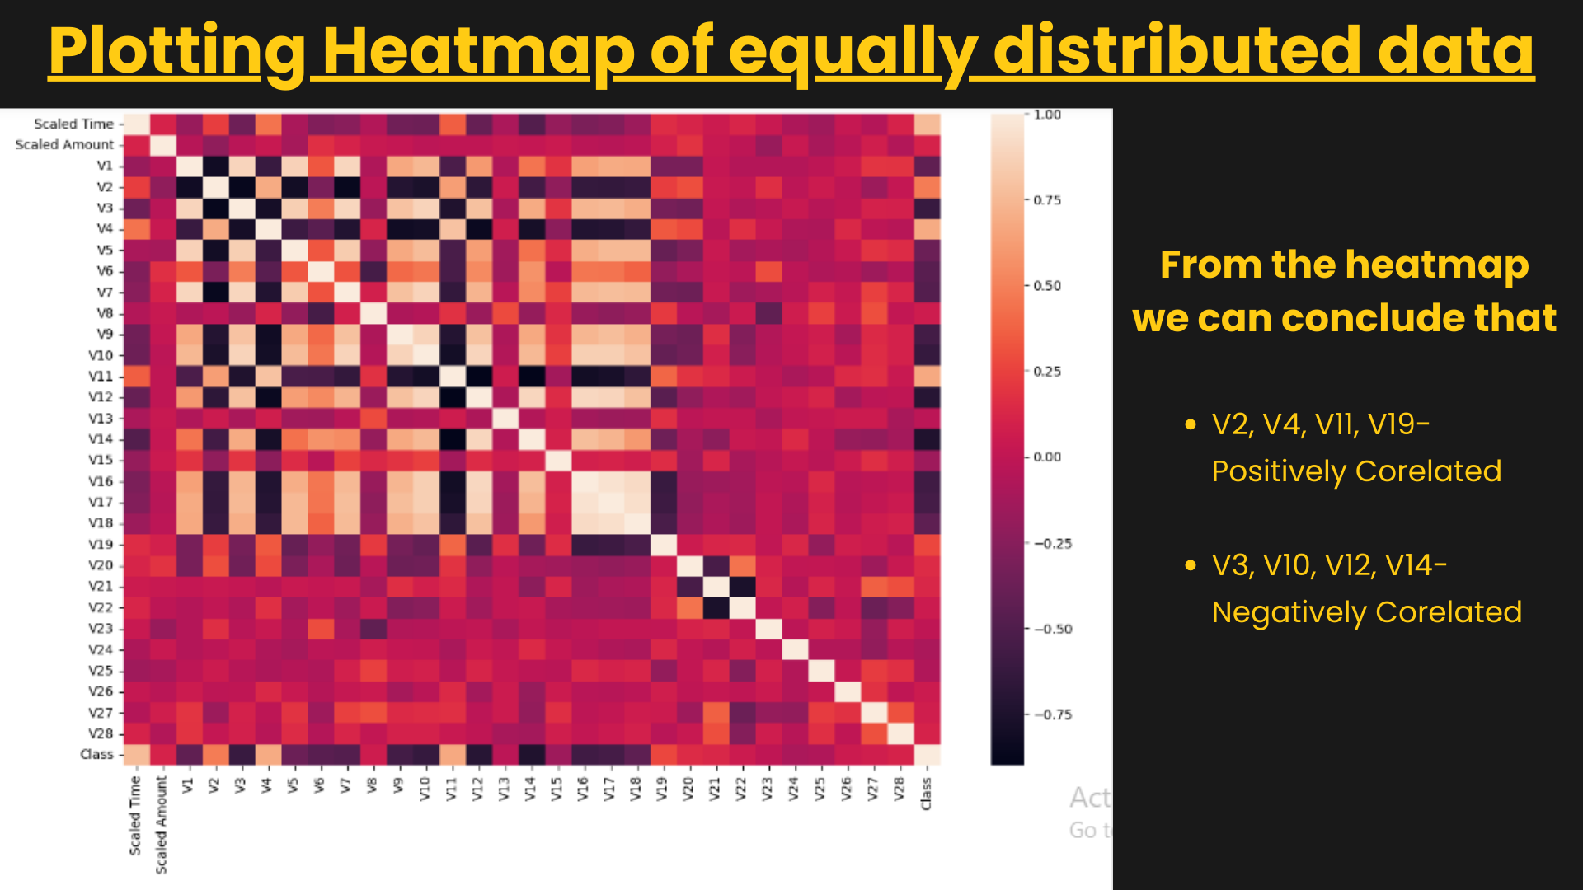

Slide 16
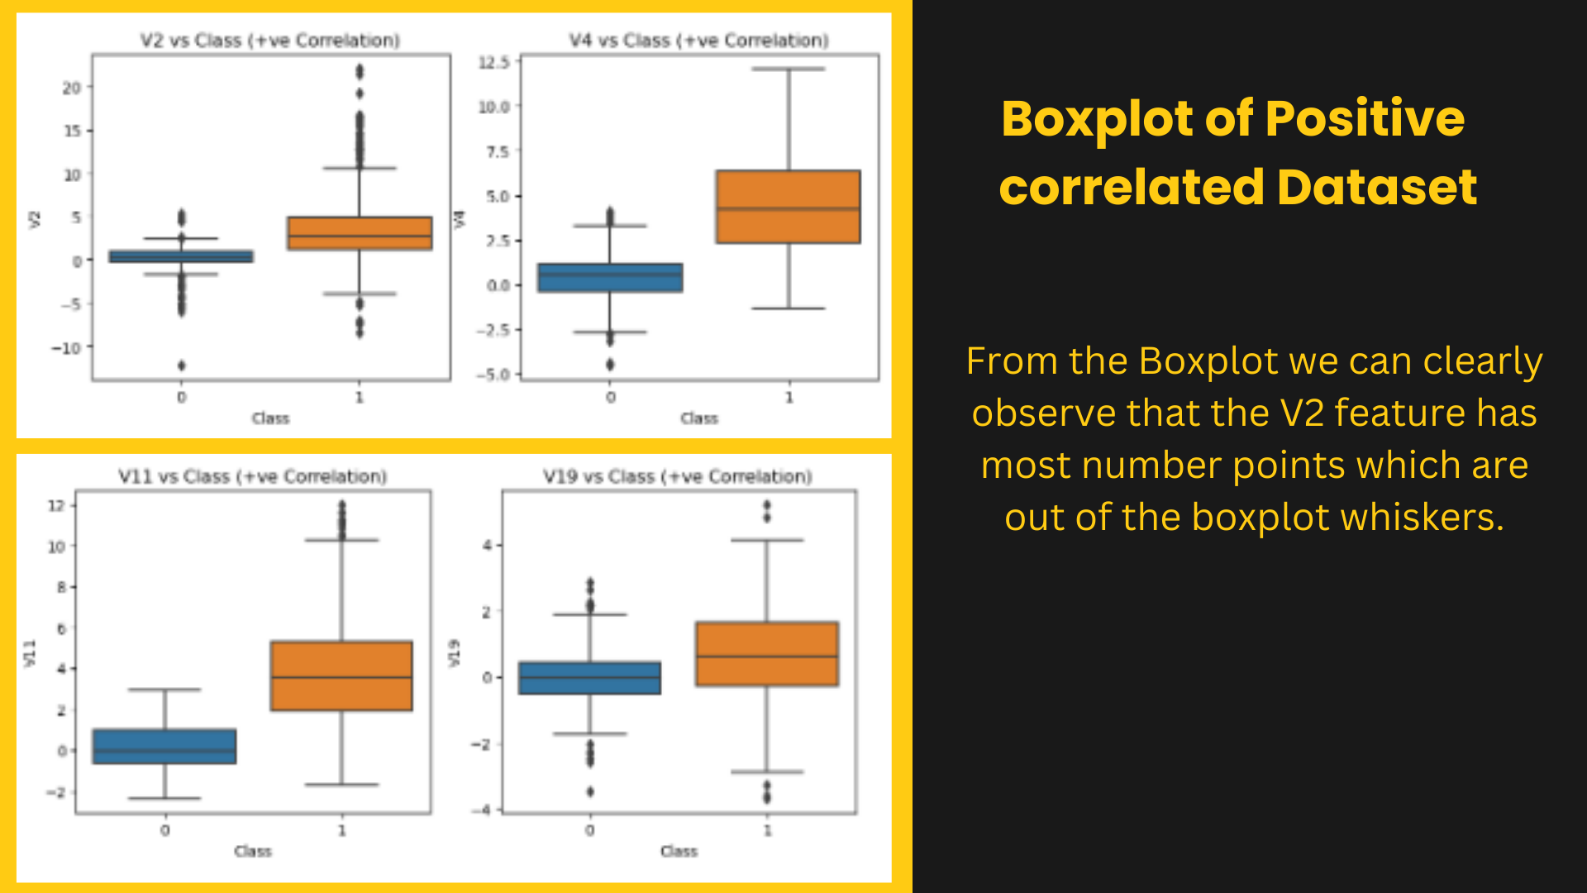

Slide 17
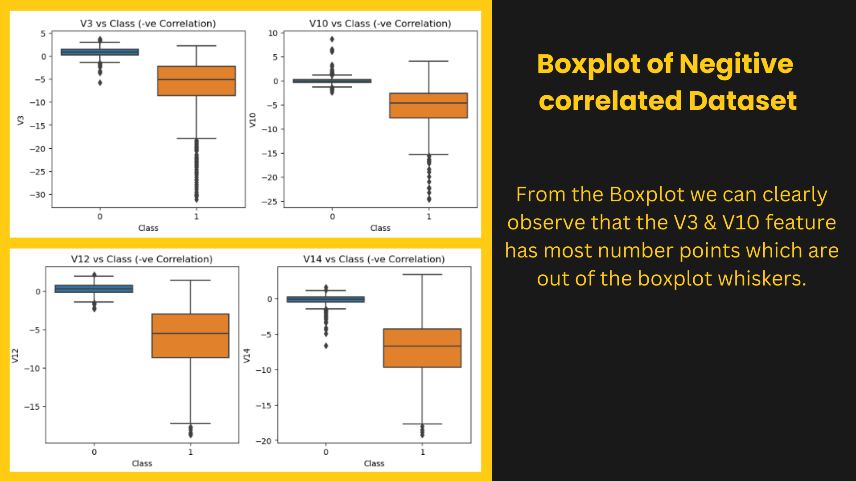

Slide 18
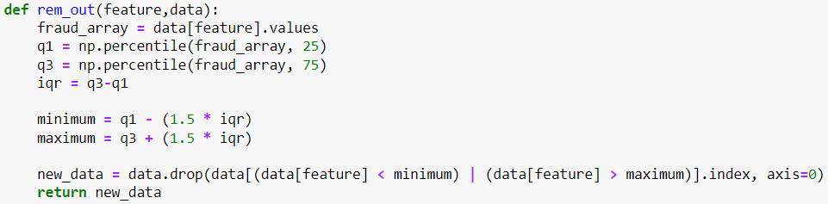
Handling Correlation Data that have high number of Outliers
Creating a function that will remove the data which are beyond the 25% to 75% of data and we keep the points that are within the desired range.

Slide 19
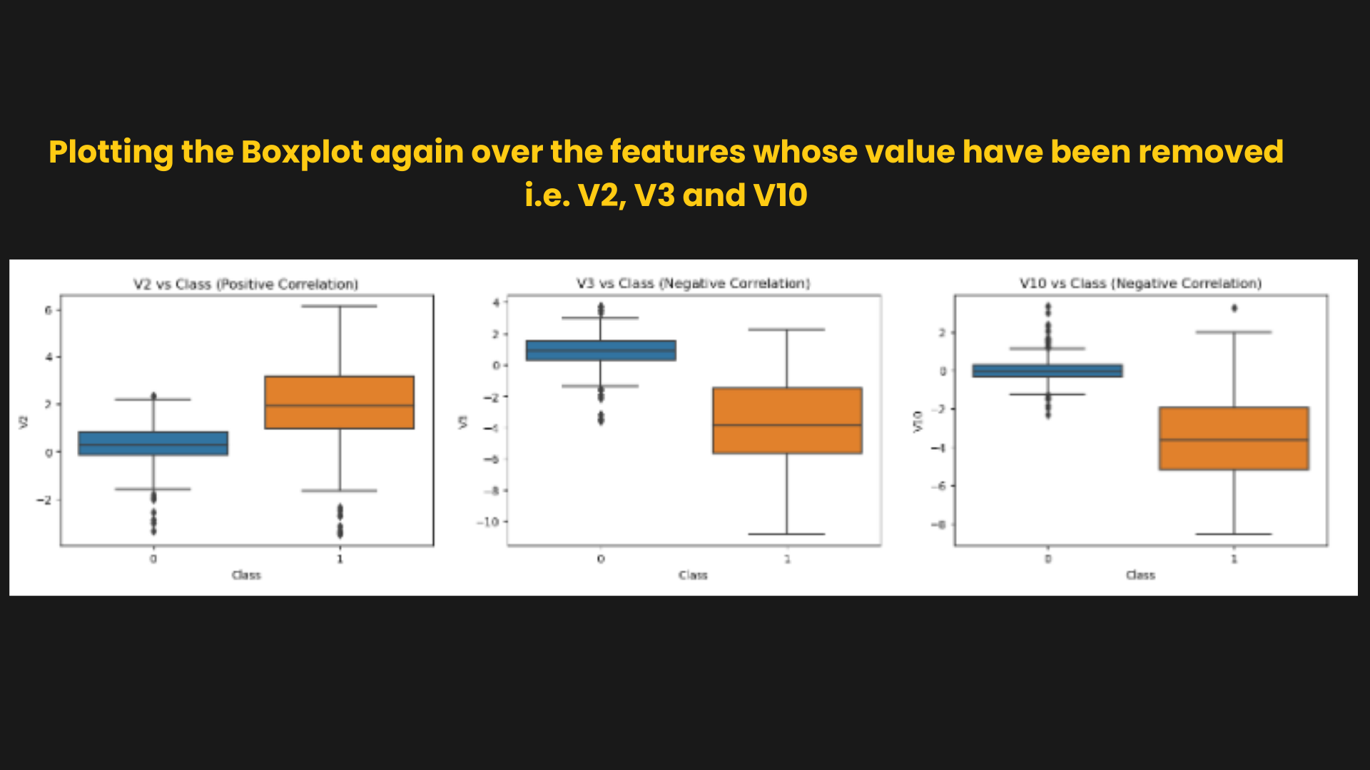

Slide 20
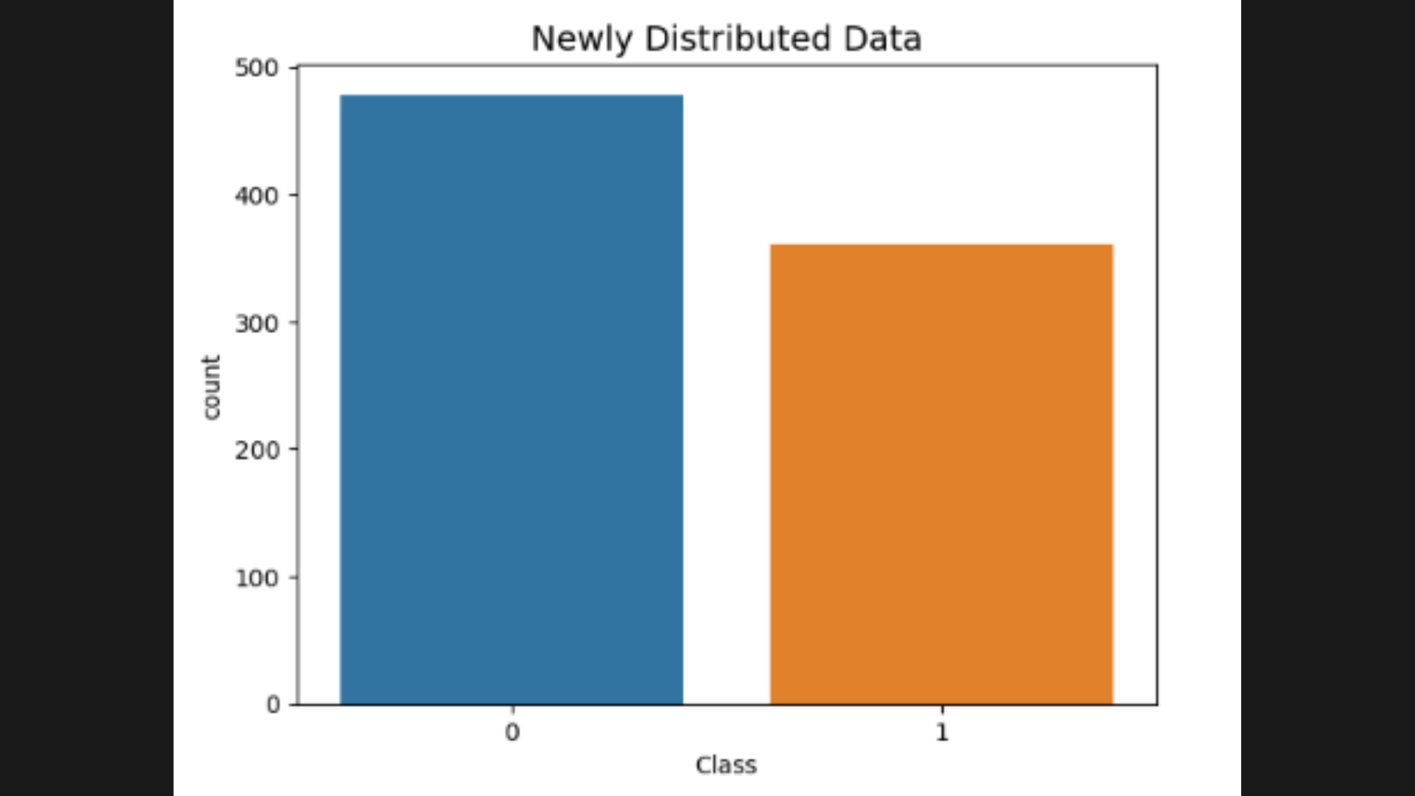

Slide 21
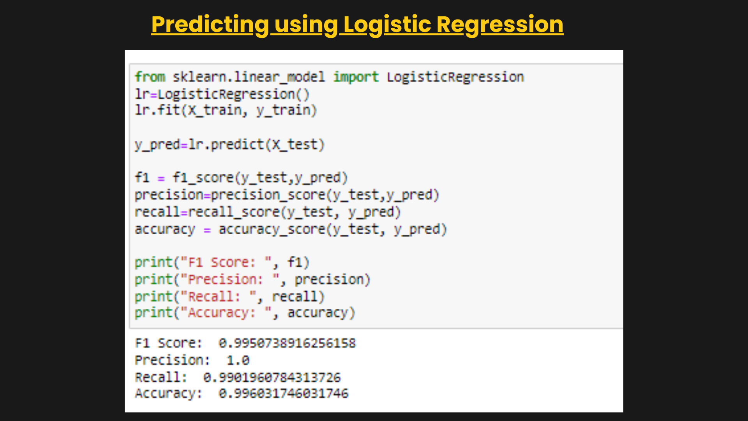

Slide 22
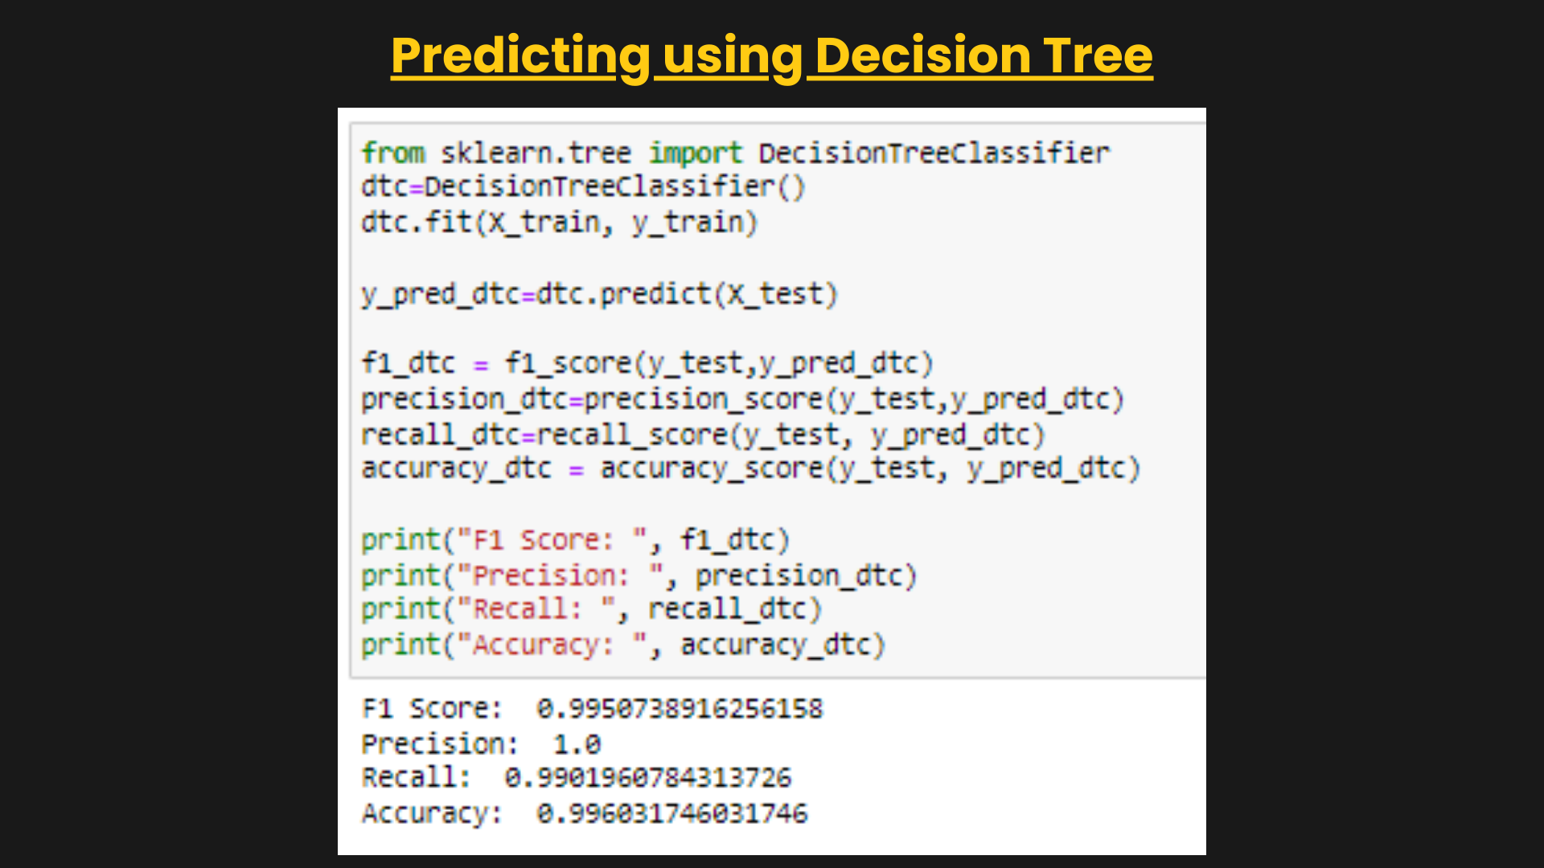

Slide 23
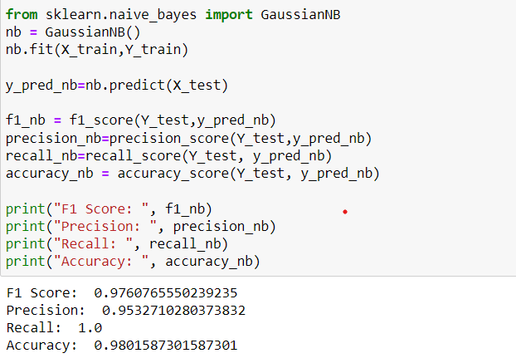
Predicting using Naïve Bayes

Slide 24
Logistic Regression, Naive Bayes and Decision Tree all three models give almost the same score on various Matrix Score

Slide 25


